Slide 1
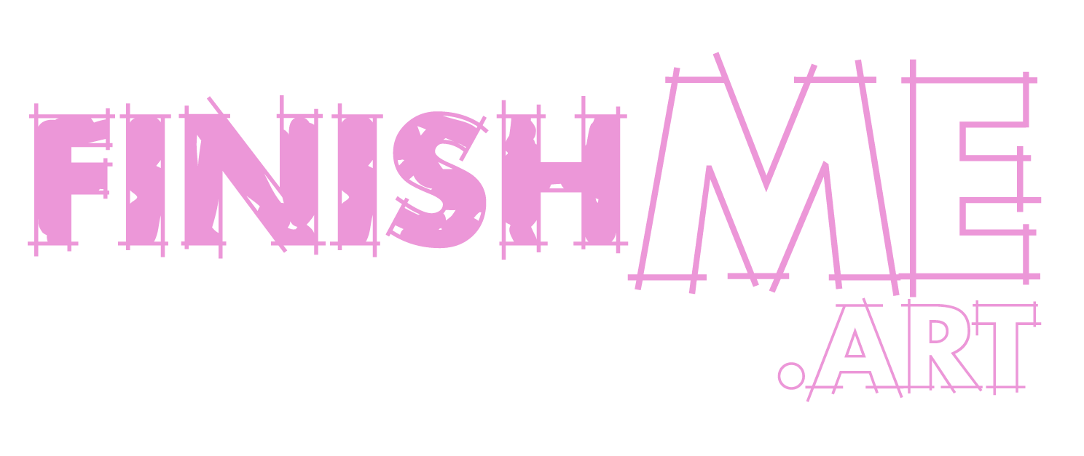
Welcome!
A platform for WDKA students aimed at connecting artists through their unfinished works.
Group 11
Rachel, Roos, Lukas

Slide 2
OUR CONCEPT
As artists, we often start working on projects which we never get around to finishing.
What is an unfinished, cast-aside project for one artist can be a source of inspiration for another artist.
For this reason, we wanted to create a platform where artists can view and work on each other's unfinished projects.
The result of this would be an archive of spontaneous collaborations.

Slide 3
RULES FOR NETWORK
Since our idea involved artists working on eachother's work, we came up with a set of rules to account for potential mis-use of the platform:
1) Use of the platform would be limited to WDKA students.
2) Users would have to contribute one unfinished work to be able to join the network.(this way we eliminate artists joining only to take works from other artists).
3) For every unfinished work that an artist wants to work on, they would have to contribute one unfinished work their own to the network.
4) Artists who exchange work would sign some form of contract between themselves to ensure that both parties are in full agreement during the process.

Slide 4
WHAT MAKES IT LOCAL?
For our network to be local and autonomous, ideally we would have had the entire plaform function through a captive portal which we set up.
This would be set up in a specific location within the academy and users can access the our platform by "accessing the wifi"

Slide 5
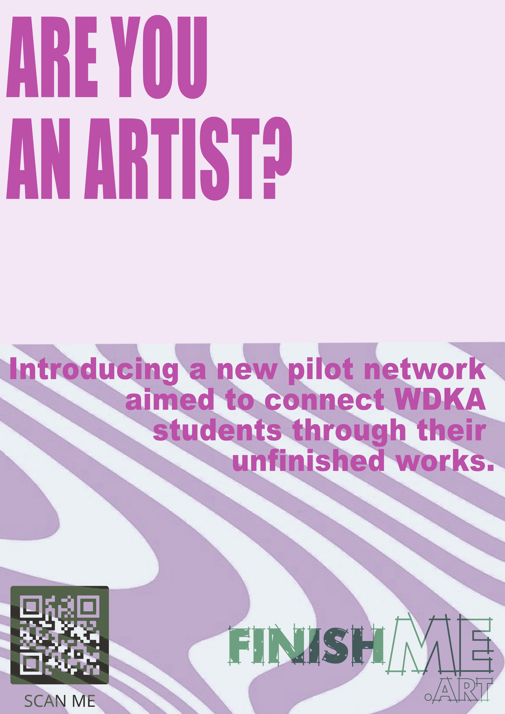
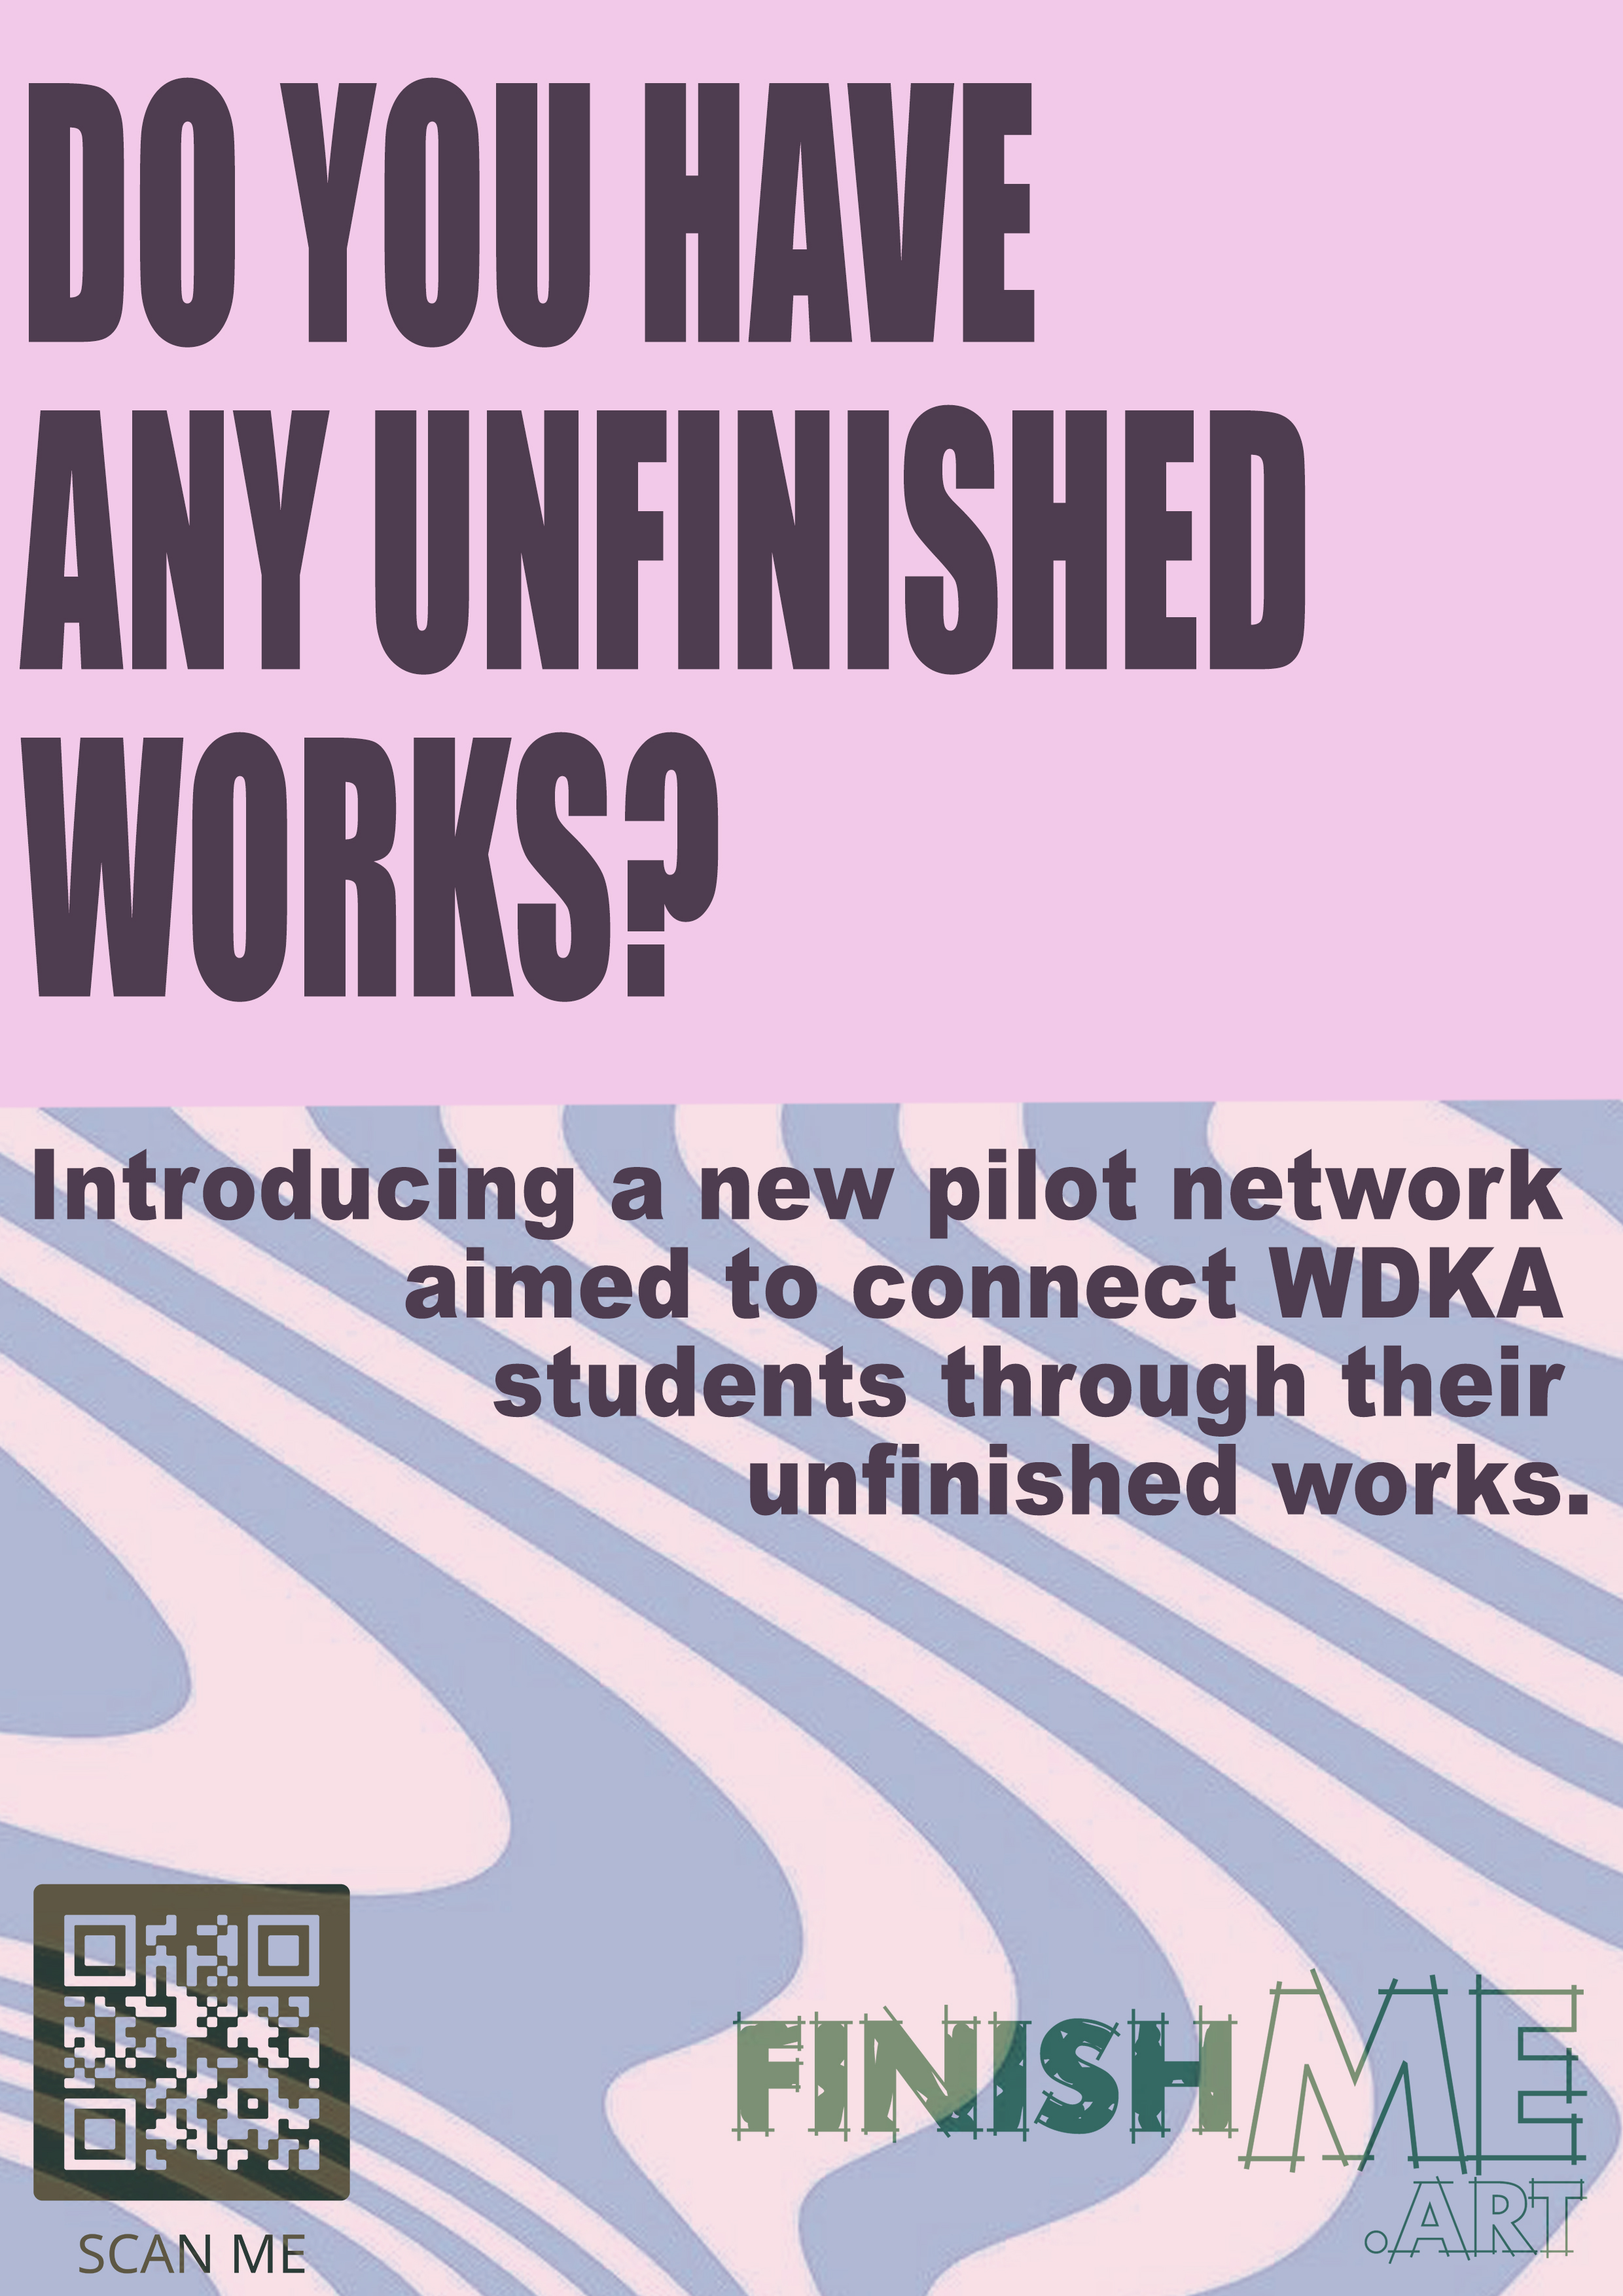
GETTING PEOPLE TO JOIN

Slide 6
A LOOK INTO WORKING PROTOTYPE
Prototype site

